Slide 1

Word Embeddings
Lecturer: Shangsong Liang
Sun Yat-sen University
Thanks to Chris Manning

Slide 2
Lecture Plan
Word Embeddings
Word meaning
Word2vec introduction
Word2vec objective function gradients
Optimization basics
Looking at word vectors
2

Slide 3
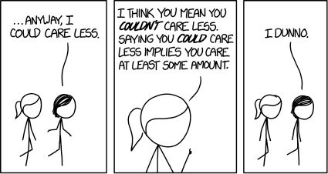
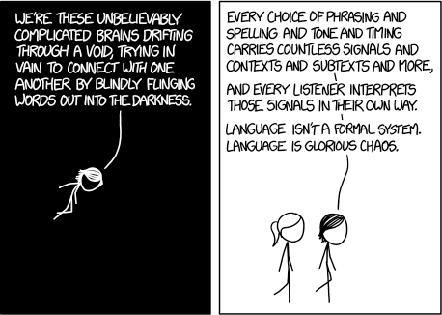
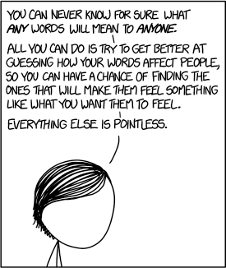
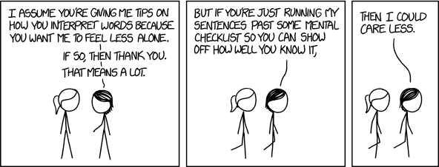
https://xkcd.com/1576/ Randall Munroe CC BY NC 2.5

Slide 4
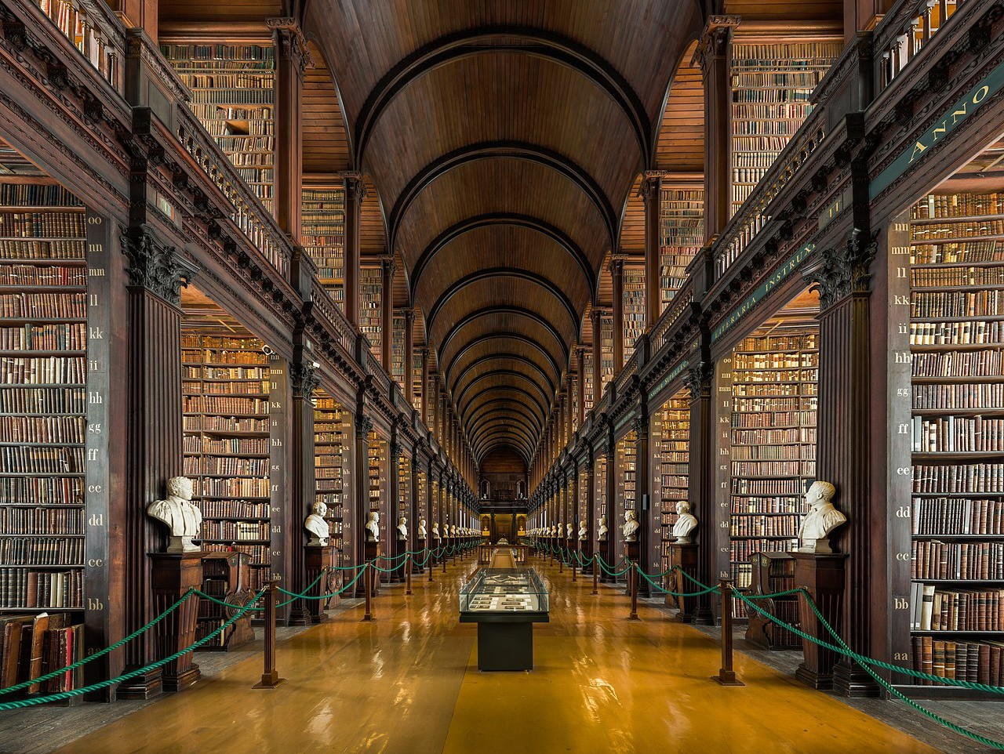

Slide 5
1. How do we represent the meaning of a word?
Definition: meaning (Webster dictionary)
the idea that is represented by a word, phrase, etc.
the idea that a person wants to express by using words, signs, etc.
the idea that is expressed in a work of writing, art, etc. Commonest linguistic way of thinking of meaning:
signifier (symbol) ⟺ signified (idea or thing)
= denotational (命名的) semantics
11

Slide 6
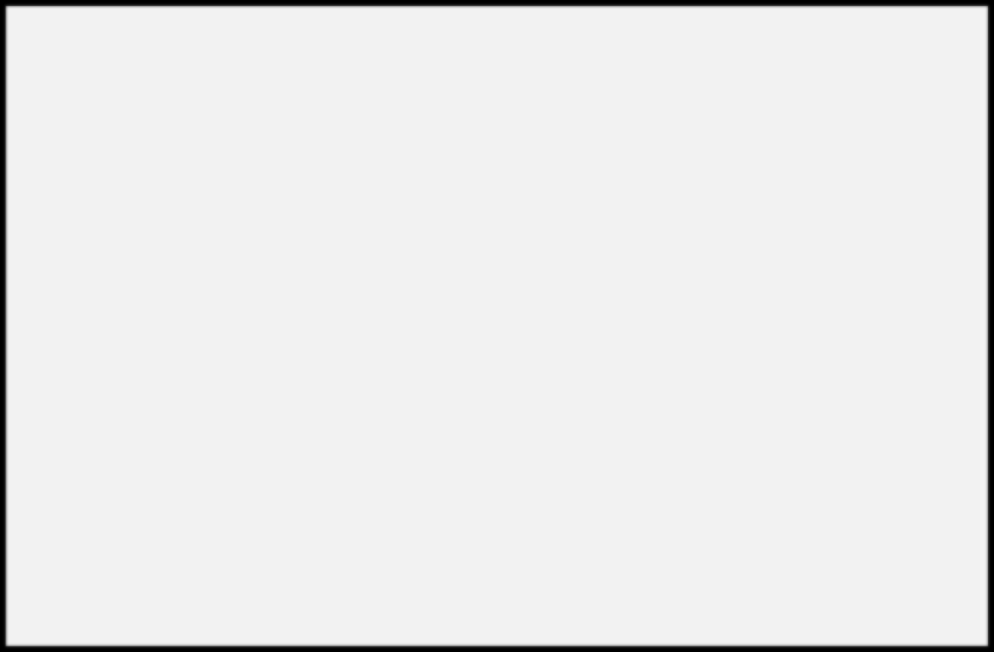
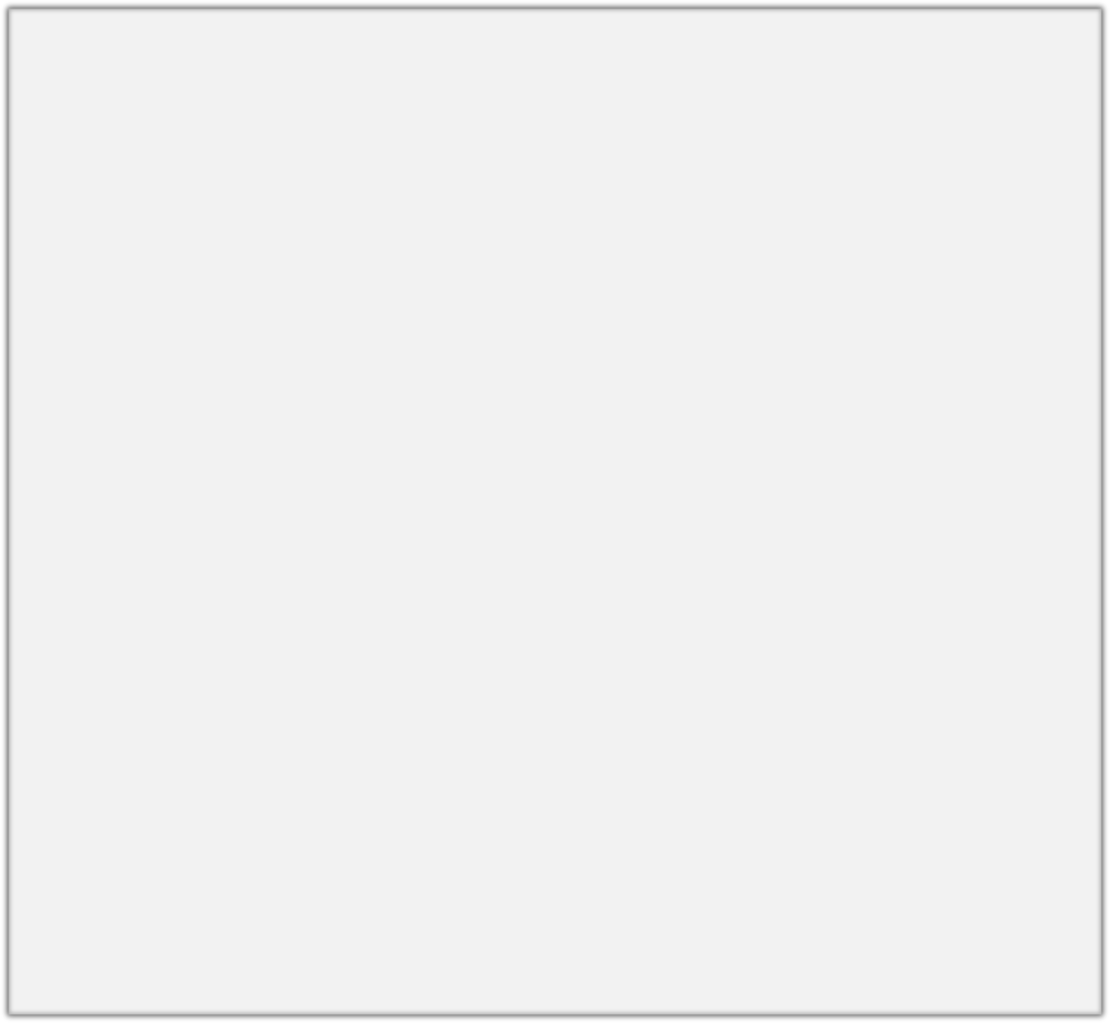
How do we have usable meaning in a computer?
Common solution: Use e.g. WordNet, a thesaurus containing lists of synonym sets and hypernyms (“is a” relationships).
e.g. synonym sets containing “good”: e.g. hypernyms of “panda”:
from nltk.corpus import wordnet as wn
poses = { 'n':'noun', 'v':'verb', 's':'adj (s)', 'a':'adj', 'r':'adv'}
for synset in wn.synsets("good"):
print("{}: {}".format(poses[synset.pos()],
", ".join([l.name() for l in synset.lemmas()])))
from nltk.corpus import wordnet as wn panda = wn.synset("panda.n.01") hyper = lambda s: s.hypernyms() list(panda.closure(hyper))
noun: good
noun: good, goodness noun: good, goodness
noun: commodity, trade_good, good adj: good
adj (sat): full, good adj: good
adj (sat): estimable, good, honorable, respectable adj (sat): beneficial, good
adj (sat): good
adj (sat): good, just, upright
…
adverb: well, good
adverb: thoroughly, soundly, good
[Synset('procyonid.n.01'), Synset('carnivore.n.01'), Synset('placental.n.01'), Synset('mammal.n.01'), Synset('vertebrate.n.01'), Synset('chordate.n.01'), Synset('animal.n.01'), Synset('organism.n.01'), Synset('living_thing.n.01'), Synset('whole.n.02'),
Synset('object.n.01'), Synset('physical_entity.n.01'), Synset('entity.n.01')]

Slide 7
Problems with resources like WordNet
Great as a resource but missing nuance (细微差别)
  e.g. “proficient” is listed as a synonym for “good”. This is only correct in some contexts.
Missing new meanings of words
  e.g., wicked, badass, nifty, wizard, genius, ninja, bombest
  Impossible to keep up-to-date!
Subjective
Requires human labor to create and adapt
Can’t compute accurate word similarity →

Slide 8
Representing words as discrete symbols
In traditional NLP, we regard words as discrete symbols: hotel, conference, motel – a localist representation
Means one 1, the rest 0s
Words can be represented by one-hot vectors:
motel = [0 0 0 0 0 0 0 0 0 0 1 0 0 0 0]
hotel = [0 0 0 0 0 0 0 1 0 0 0 0 0 0 0]
Vector dimension = number of words in vocabulary (e.g., 500,000)

Slide 9
Problem with words as discrete symbols
Sec. 9.2.2
Example: in web search, if user searches for “Seattle motel”, we would like to match documents containing “Seattle hotel”.
But:
motel = [0 0 0 0 0 0 0 0 0 0 1 0 0 0 0]
hotel = [0 0 0 0 0 0 0 1 0 0 0 0 0 0 0]
These two vectors are orthogonal.
There is no natural notion of similarity for one-hot vectors!
Solution:
Could try to rely on WordNet’s list of synonyms(同义词) to get similarity?
  But it is well-known to fail badly: incompleteness, etc.
Instead: learn to encode similarity in the vectors themselves
Notes:
A motel, also known as a motor hotel or motor lodge, is a hotel designed for motorists, usually having each room entered directly from the parking area for motor vehicles rather than through a central lobby.
Seattle西雅图 motel 汽车旅馆

Slide 10
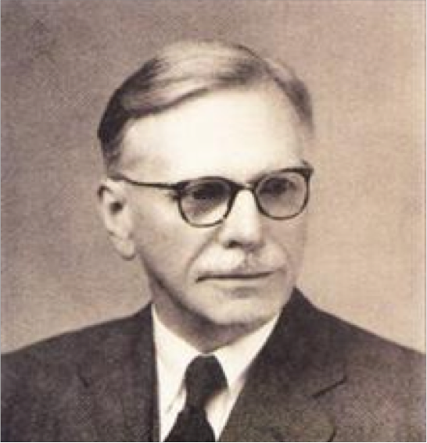
Representing words by their context
Distributional semantics: A word’s meaning is given by the words that frequently appear close-by
  “You shall know a word by the company it keeps” (J. R. Firth 1957: 11)
  One of the most successful ideas of modern statistical NLP!
When a word w appears in a text, its context is the set of words that appear nearby (within a fixed-size window).
Use the many contexts of w to build up a representation of w
…government debt problems turning into
…saying that Europe needs unified
…India has just given its
banking
banking banking
crises as happened in 2009…
regulation to replace the hodgepodge… system a shot in the arm…
16
These context words will represent banking

Slide 11
Word vectors
We will build a dense vector for each word, chosen so that it is similar to vectors of words that appear in similar contexts
0.286
0.792
−0.177
−0.107
0.109
−0.542
0.349
0.271
banking =
Note: word vectors are sometimes called word embeddings or word representations. They are a distributed representation.

Slide 12
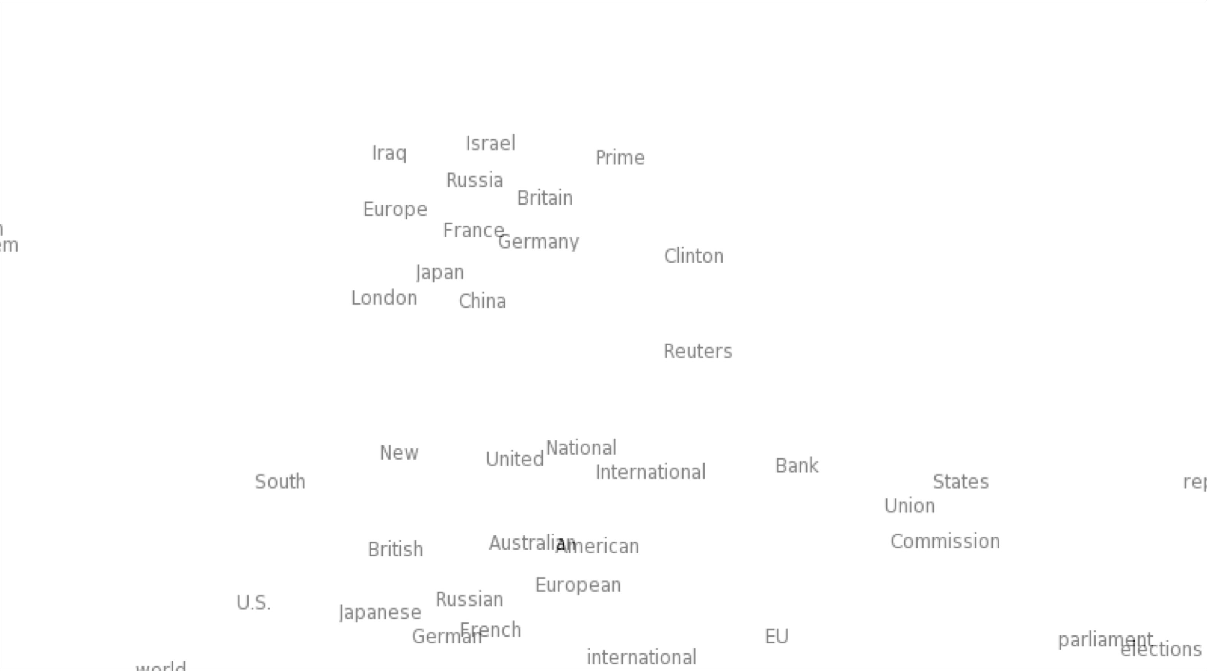
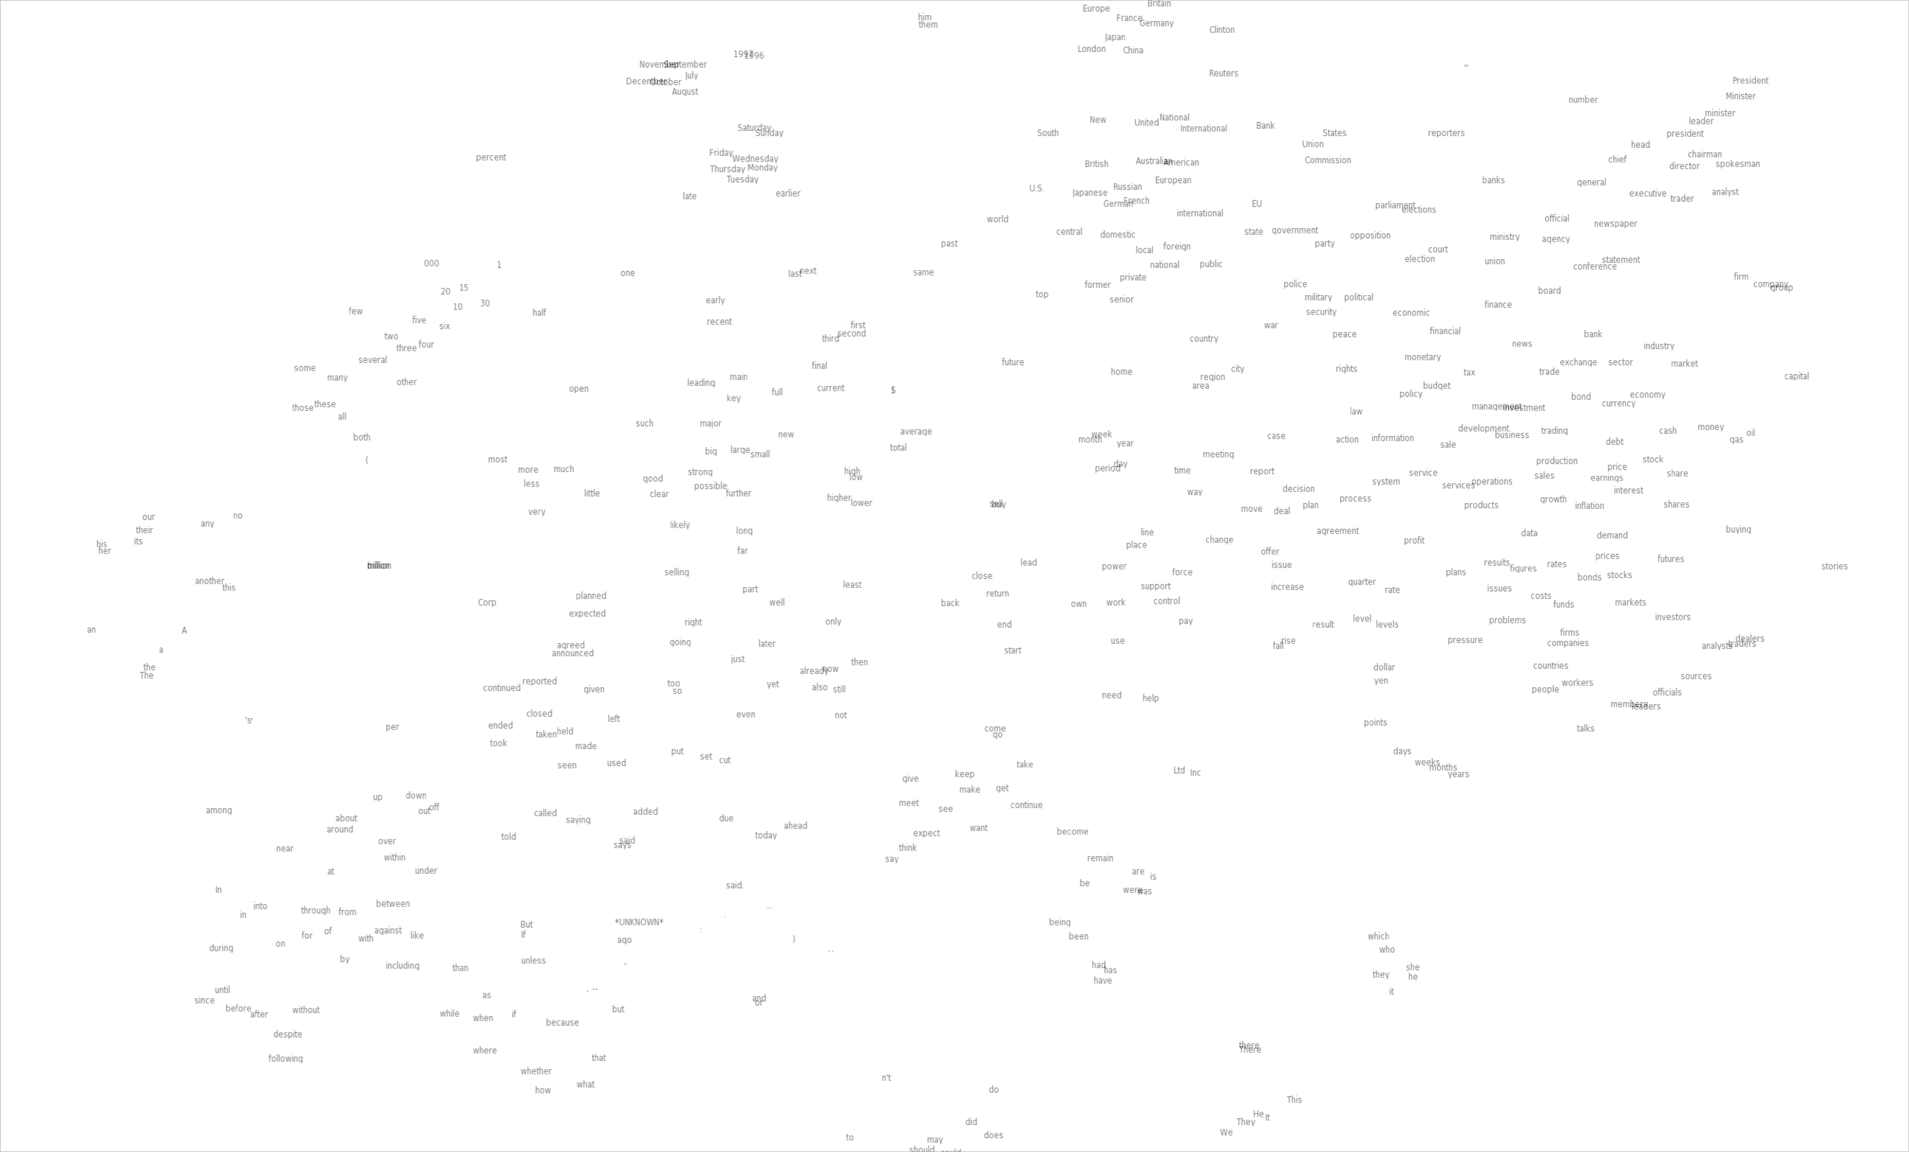
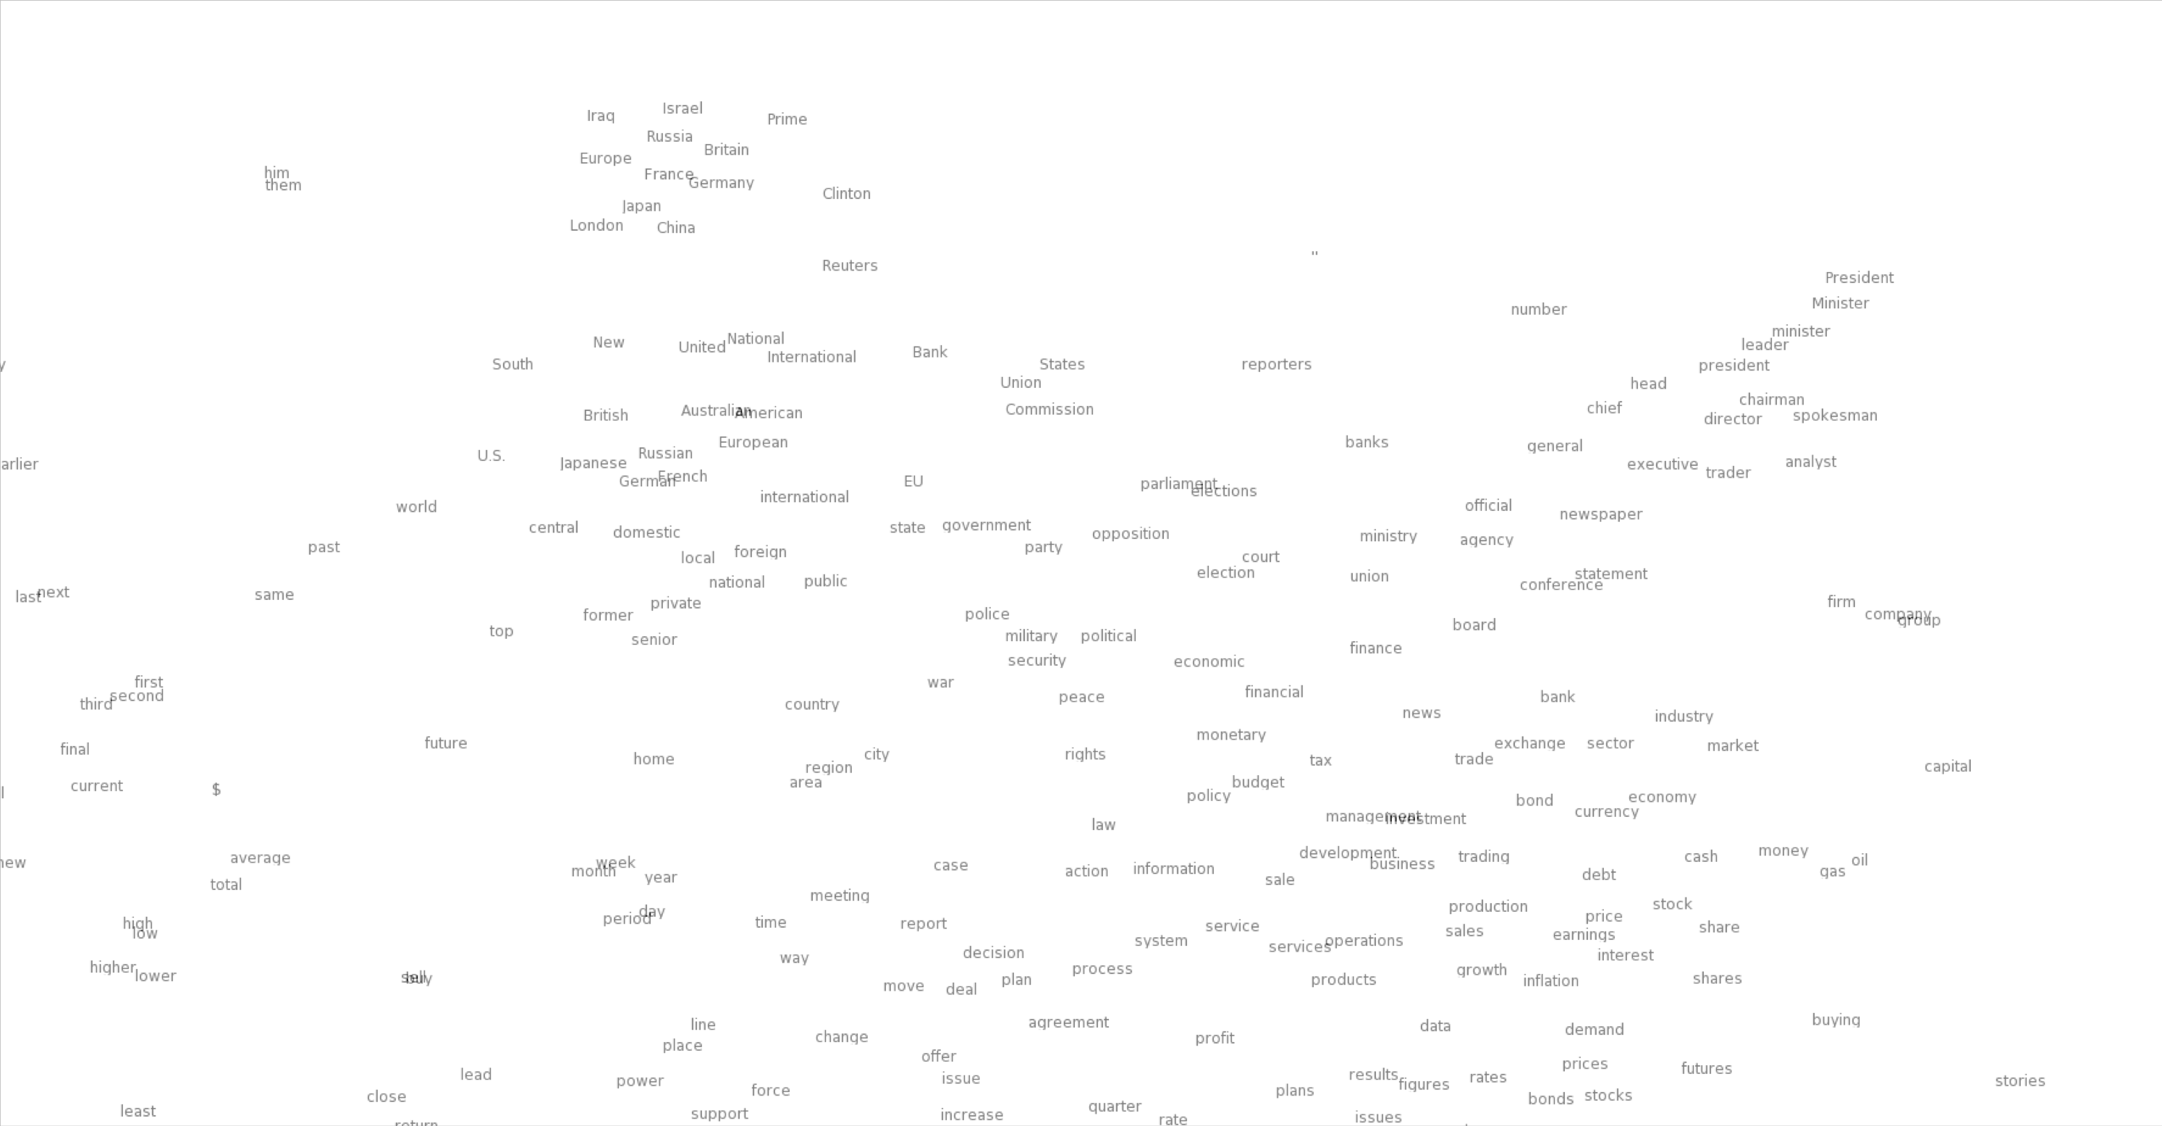
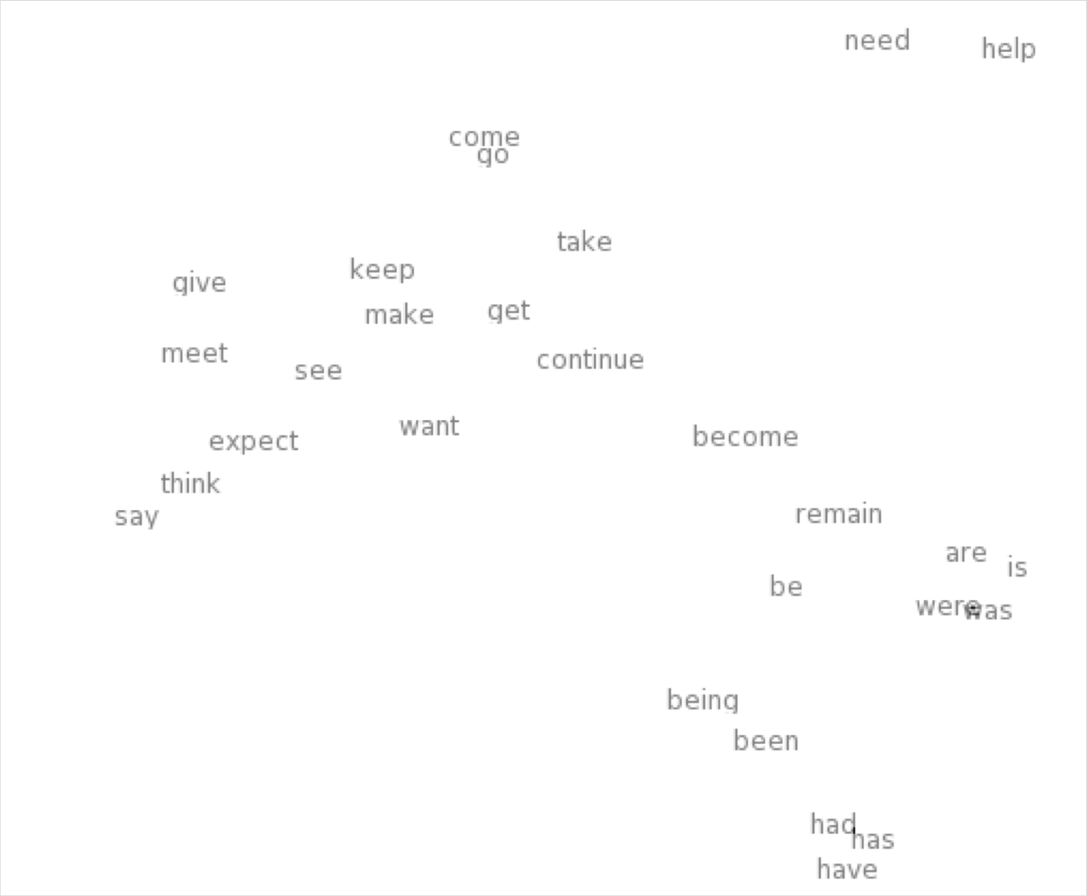
Word meaning as a neural word vector – visualization
0.286
0.792
−0.177
−0.107
0.109
−0.542
0.349
0.271
0.487
expect =

Slide 13
3. Word2vec: Overview
Word2vec (Mikolov et al. 2013) is a framework for learning word vectors:
Mikolov et al., Distributed representations of words and phrases and their compositionality, in NIPS 2013.
Idea:
We have a large corpus of text
Every word in a fixed vocabulary is represented by a vector
Go through each position t in the text, which has a center word
c and context (“outside”) words o
Use the similarity of the word vectors for c and o to calculate the probability of o given c (or vice versa)
Keep adjusting the word vectors to maximize this probability

Slide 14
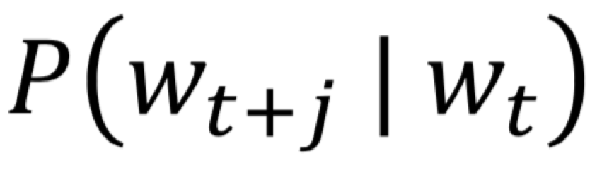
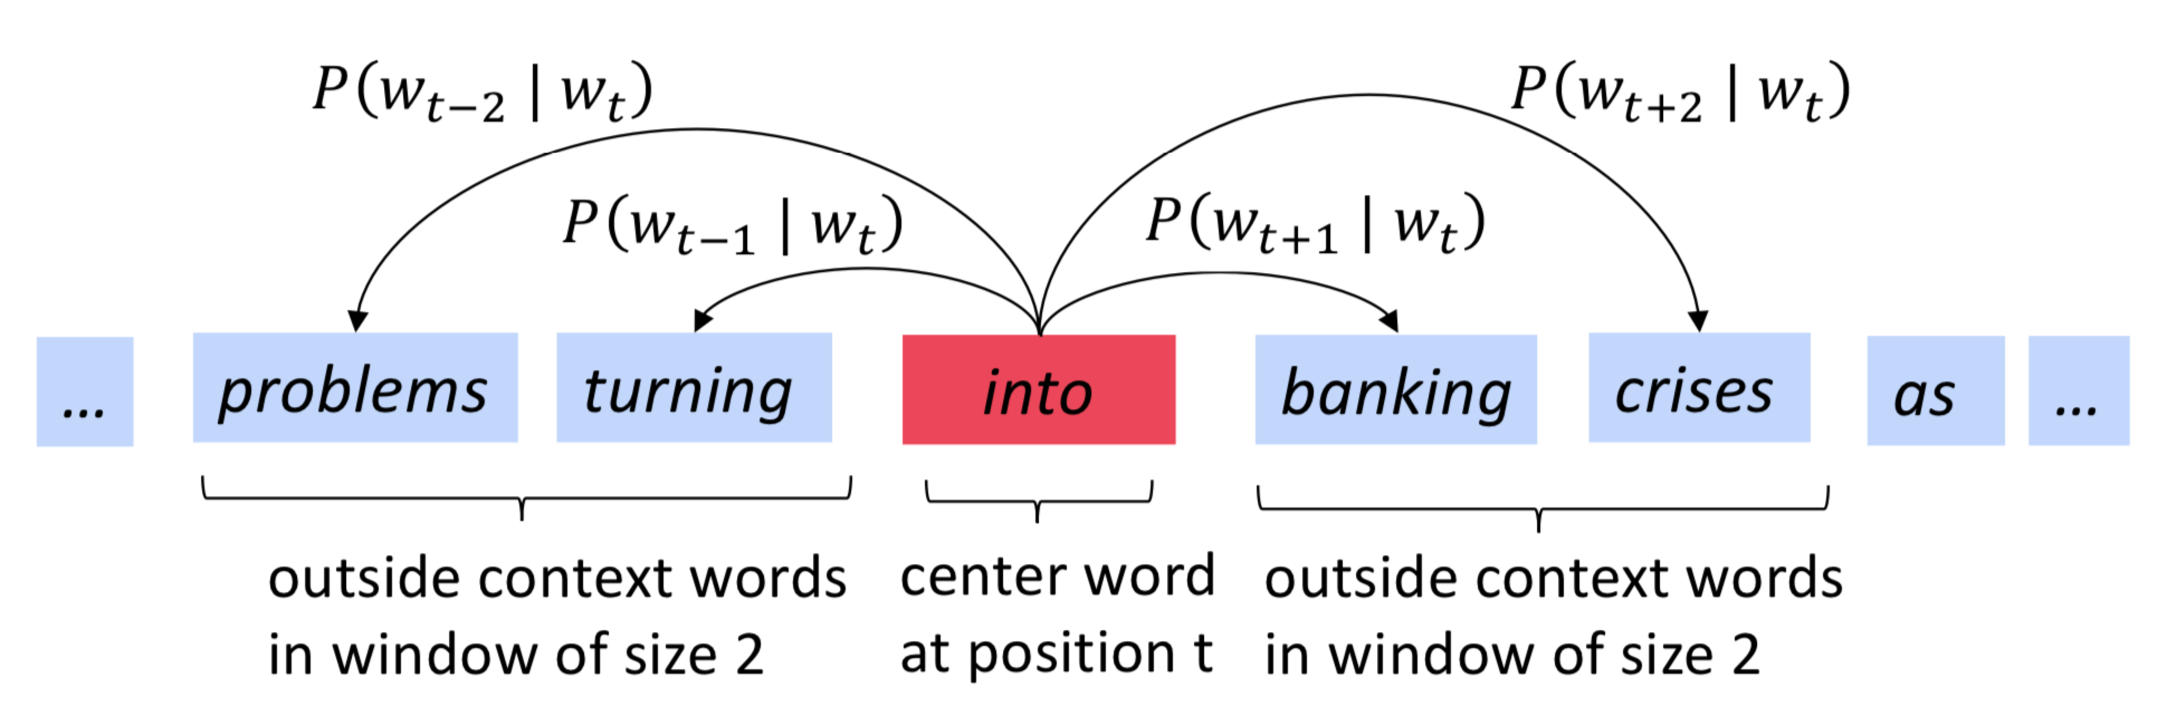
Word2Vec Overview
Example windows and process for computing

Slide 15
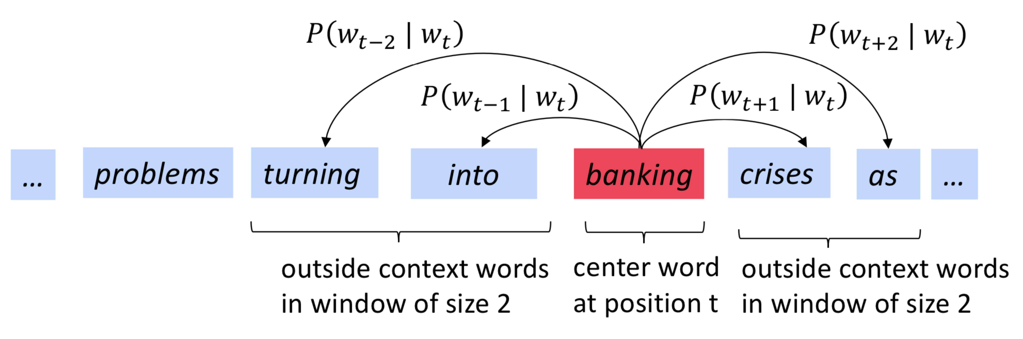
Word2Vec Overview
Example windows and process for computing

Slide 16
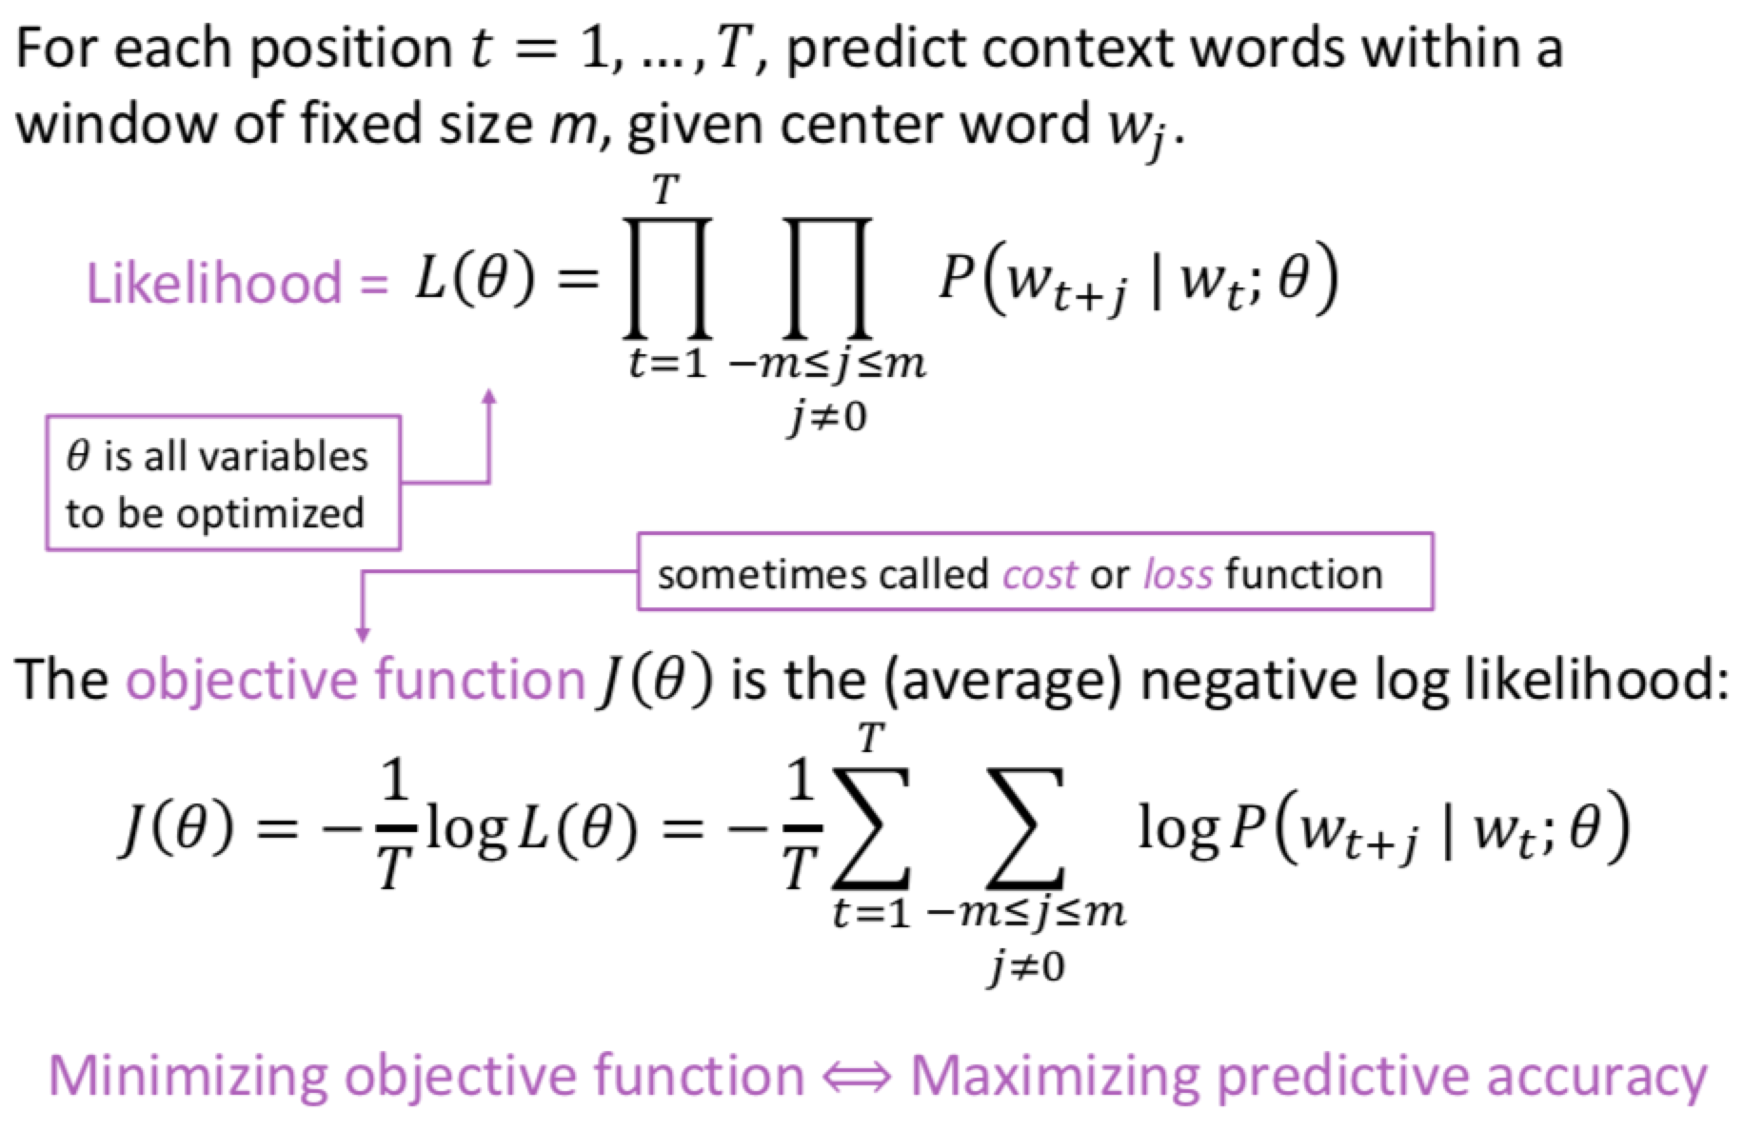
Word2vec: objective function

Slide 17
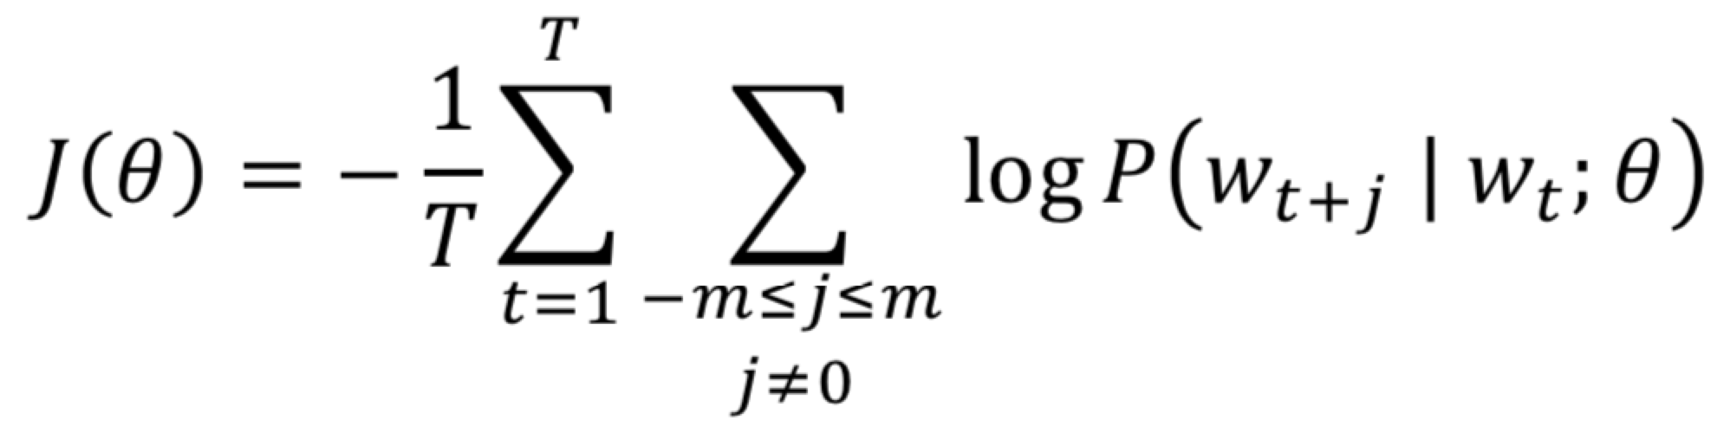
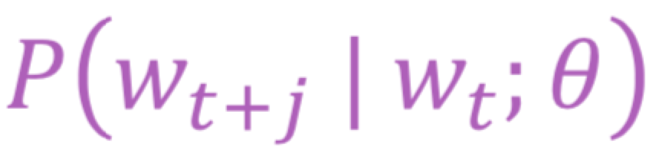

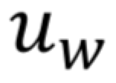
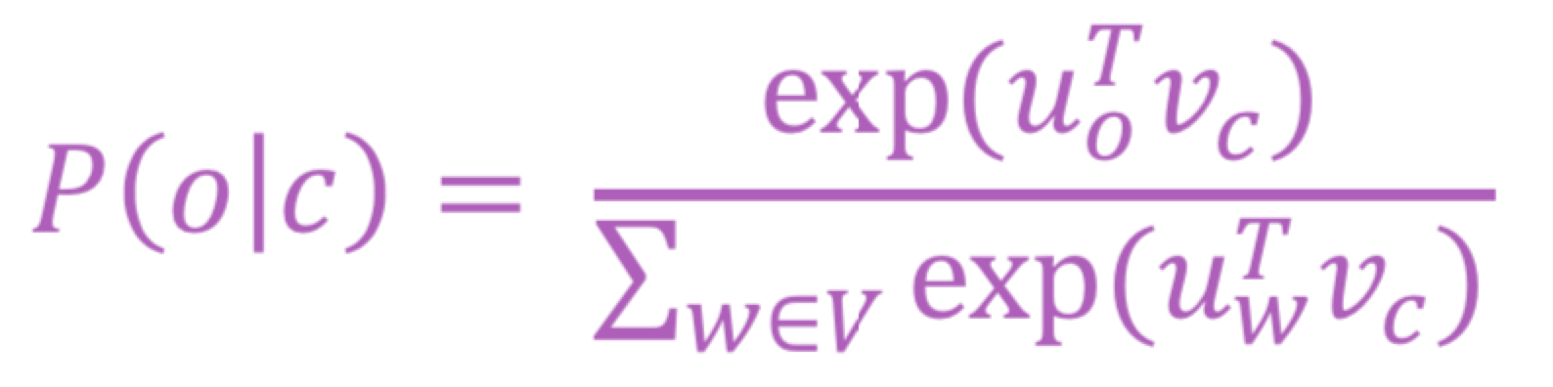
Word2vec: objective function
We want to minimize the objective function:
Question: How to calculate ?
Answer: We will use two vectors per word w:
  when w is a center word
  when w is a context word
Then for a center word c and a context word o:
23

Slide 18
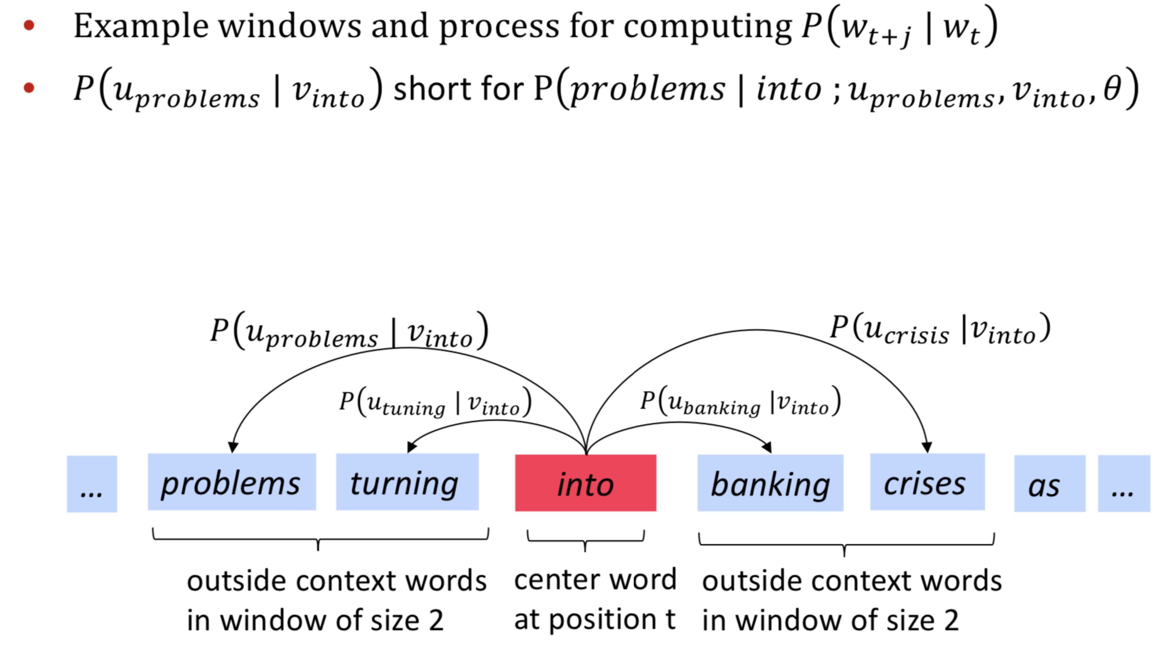
Word2Vec Overview with Vectors

Slide 19
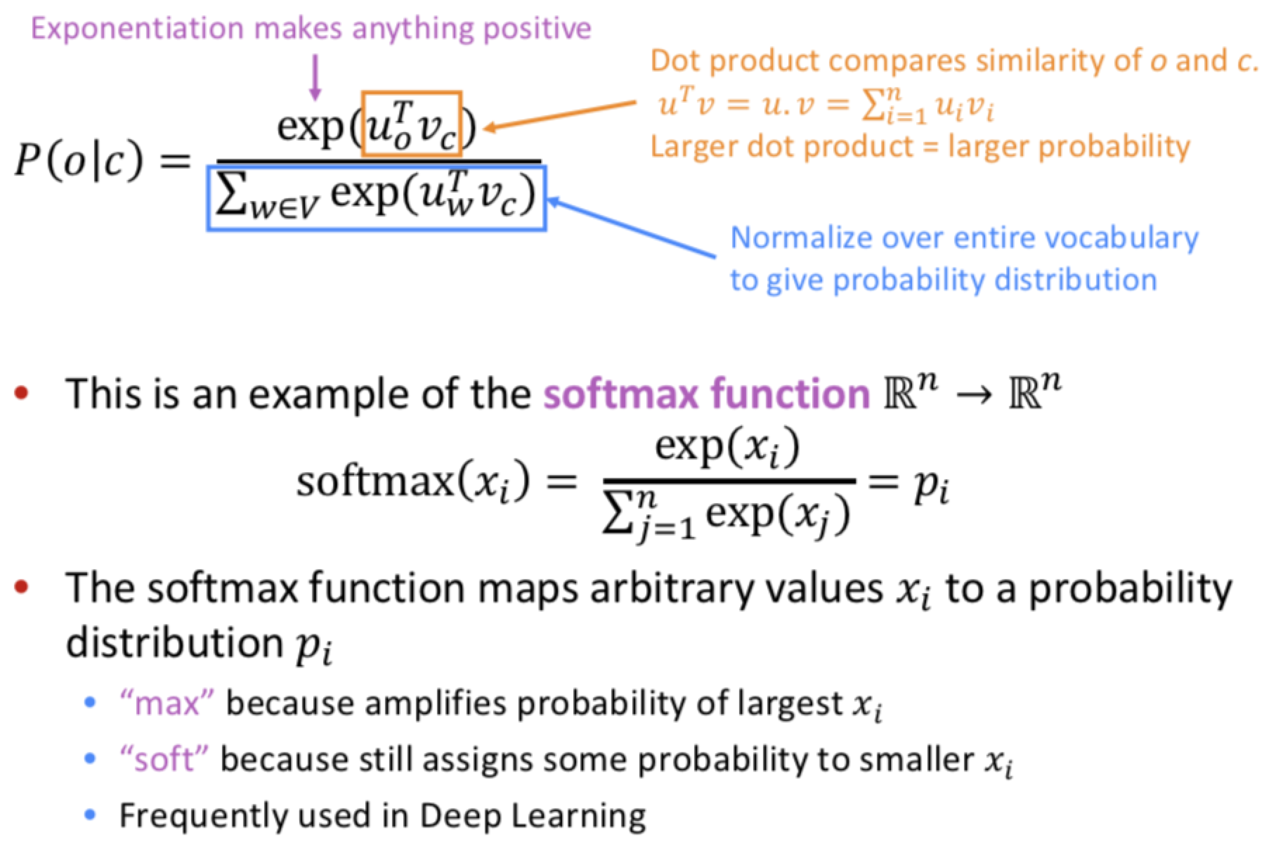
Word2vec: prediction function

Slide 20
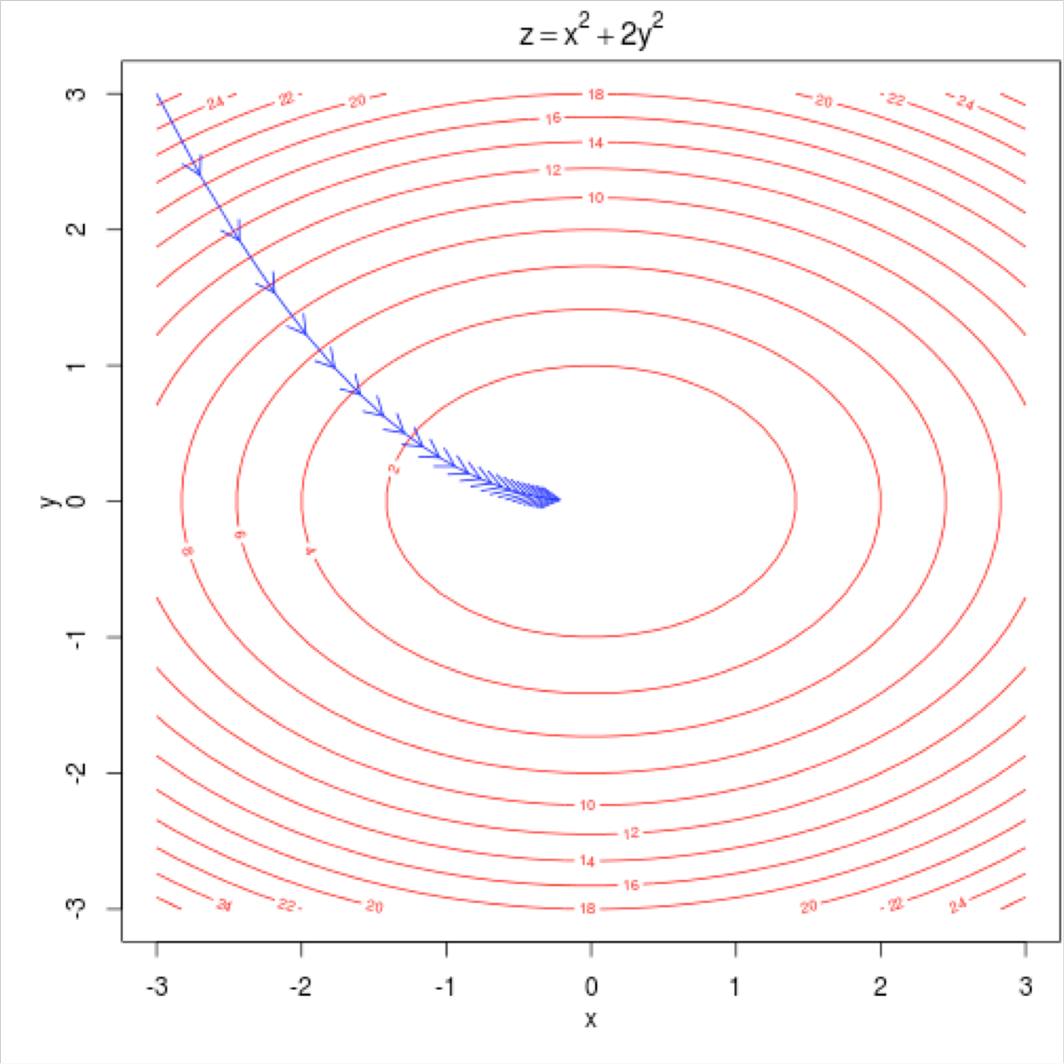
Training a model by optimizing parameters
To train a model, we adjust parameters to minimize a loss E.g., below, for a simple convex function over two parameters Contour lines show levels of objective function

Slide 21

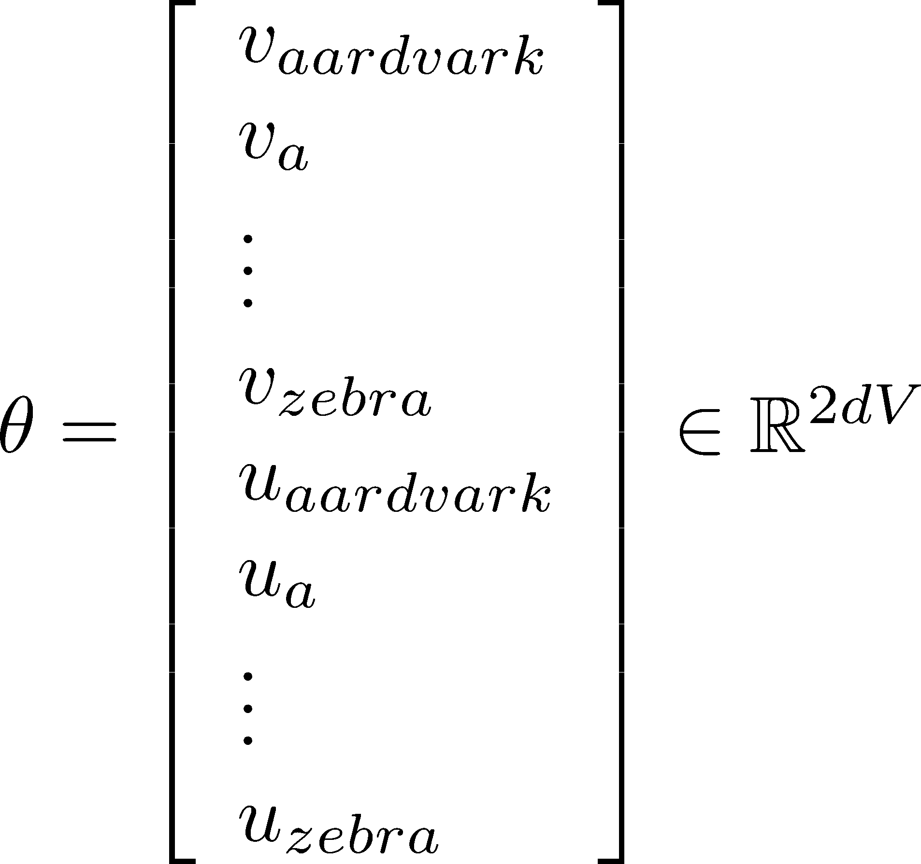
To train the model: Compute all vector gradients!
Recall: represents all model parameters, in one long vector
In our case with d-dimensional vectors and V-many words:
Remember: every word has two vectors
We optimize these parameters by walking down the gradient

Slide 22

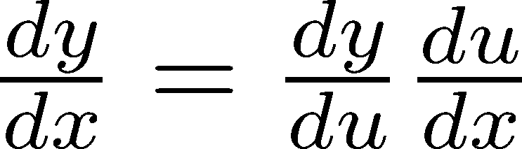
4. Word2vec derivations of gradient
Whiteboard – see video if you’re not in class ;)
The basic Lego piece
Useful basics:
If in doubt: write out with indices
Chain rule! If y = f(u) and u = g(x), i.e. y = f(g(x)), then:

Slide 23
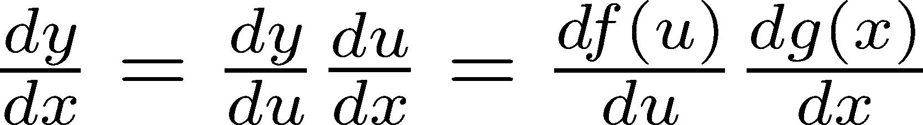
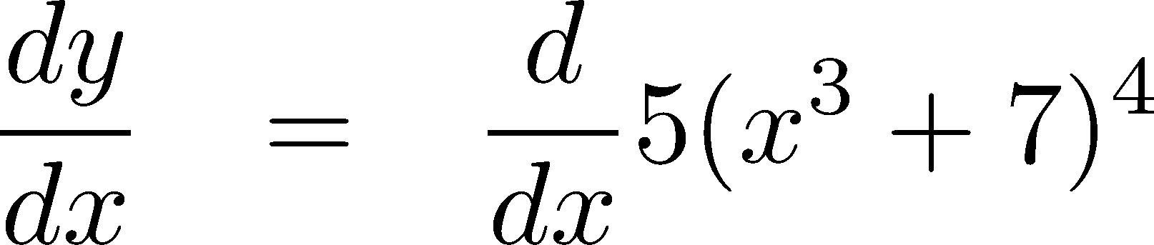
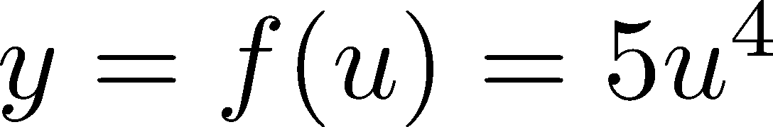
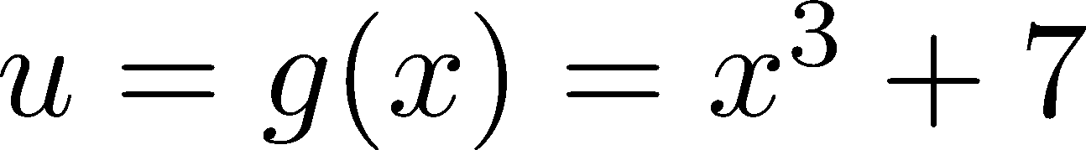
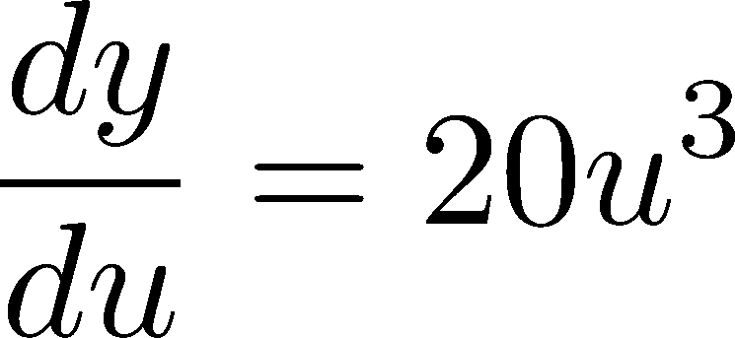
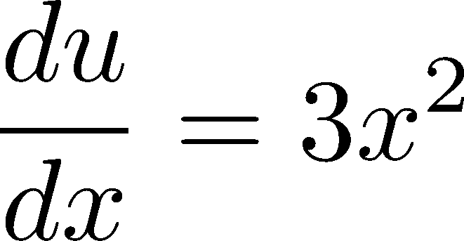
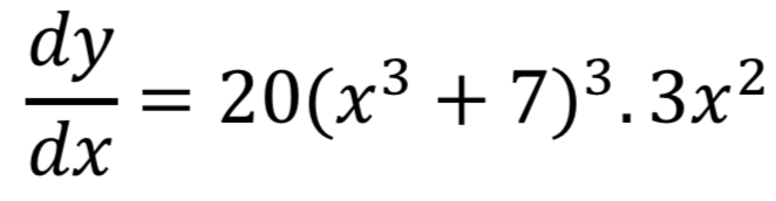
Chain Rule
Chain rule! If y = f(u) and u = g(x), i.e. y = f(g(x)), then:
Simple example:

Slide 24
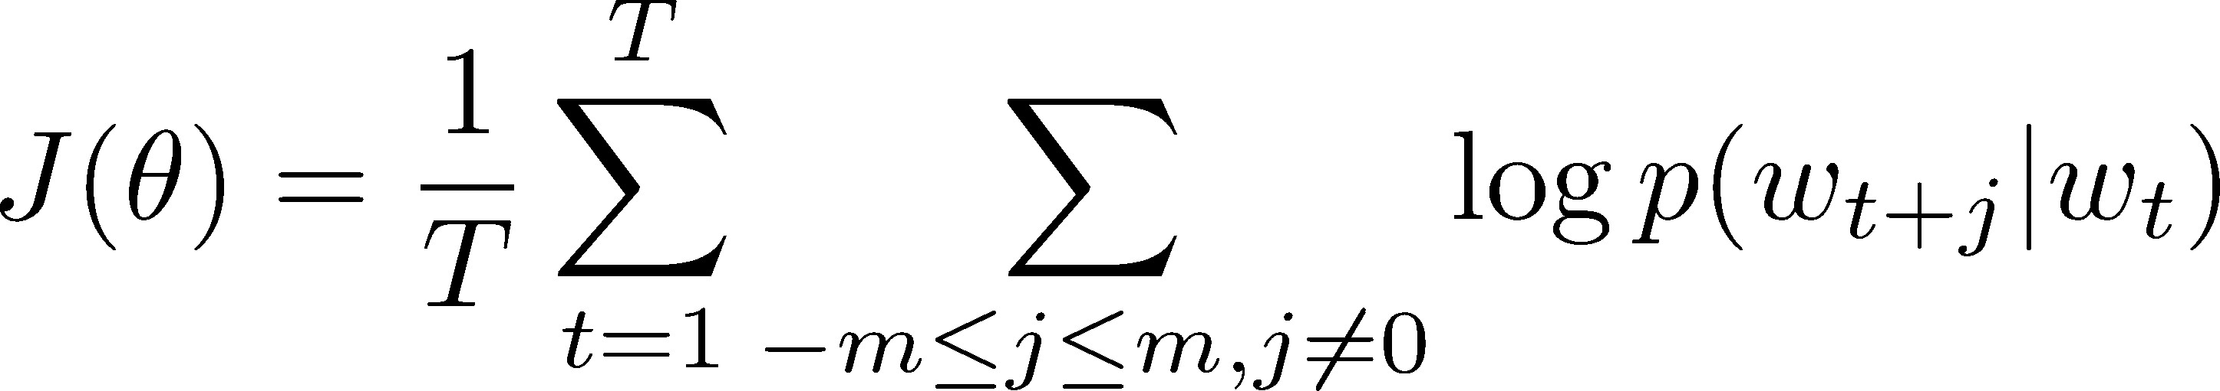
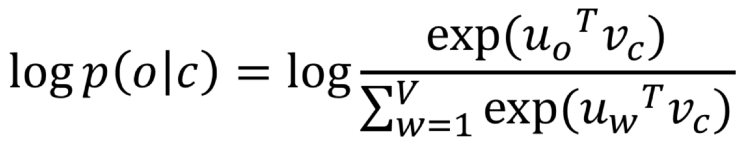

Interactive Whiteboard Session!
Let’s derive gradient for center word together
For one example window and one example outside word:
You then also need the gradient for context words (it’s similar; left for homework). That’s all of the parameters here.

Slide 25
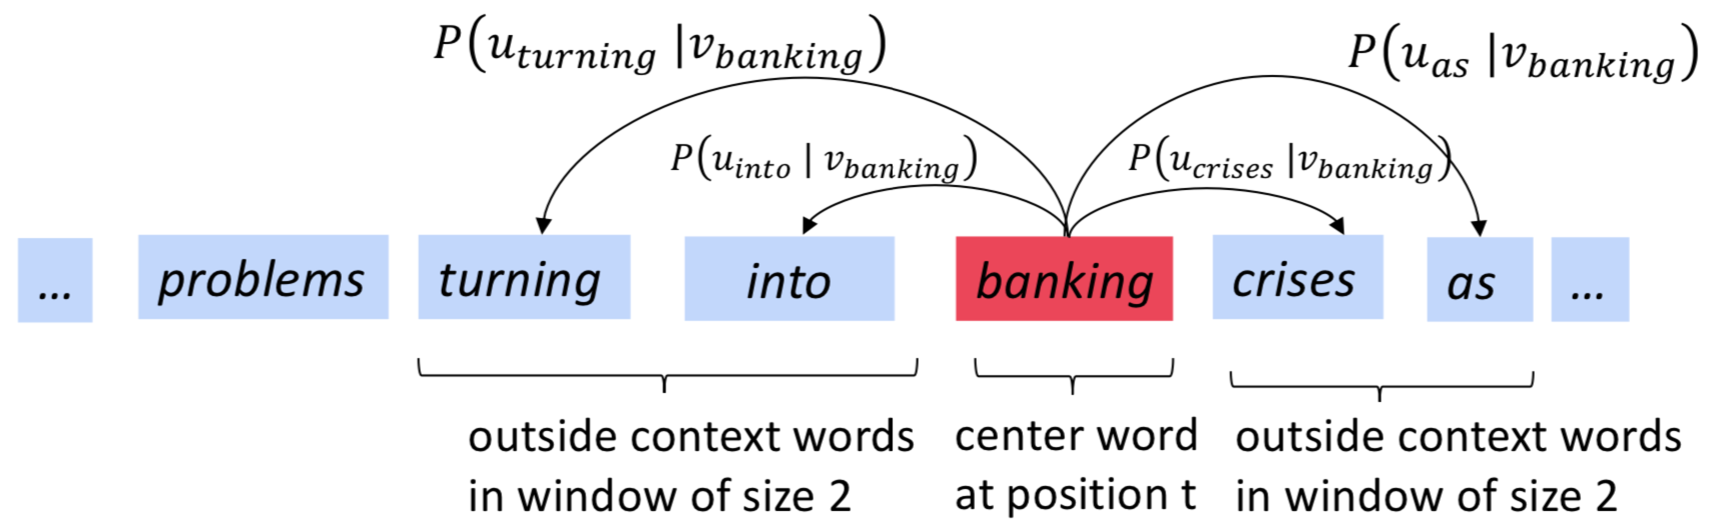
Calculating all gradients!
We went through gradient for each center vector v in a window
We also need gradients for outside vectors u
  Derive at home!
Generally in each window we will compute updates for all parameters that are being used in that window. For example:

Slide 26
Word2vec: More details
Why two vectors? → Easier optimization. Average both at the end.
Two model variants:
Skip-grams (SG)
Predict context ("outside") words (position independent) given center word
Continuous Bag of Words (CBOW)
Predict center word from (bag of) context words This lecture so far: Skip-gram model
Additional efficiency in training:
1. Negative sampling
So far: Focus on naïve softmax (simpler training method)

Slide 27
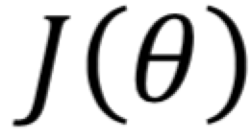
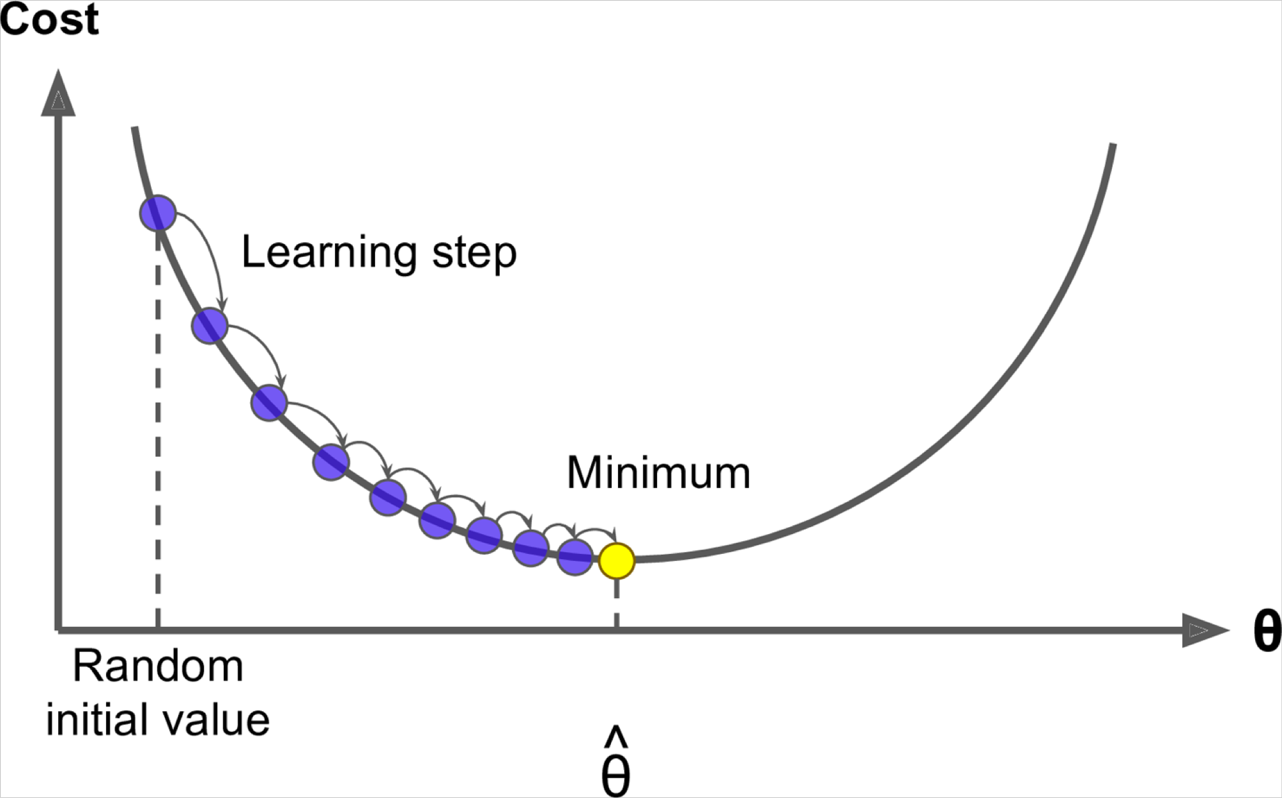
5. Optimization: Gradient Descent
We have a cost function we want to minimize
Gradient Descent is an algorithm to minimize
Idea: for current value of , calculate gradient of , then take small step in direction of negative gradient. Repeat.
Note: Our objectives may not be convex like this :(

Slide 28
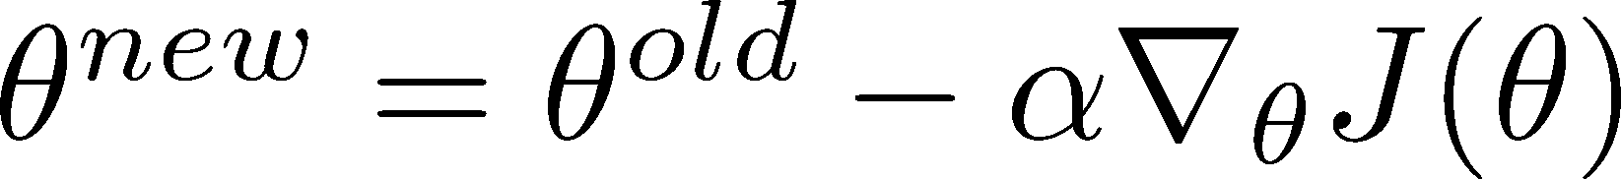

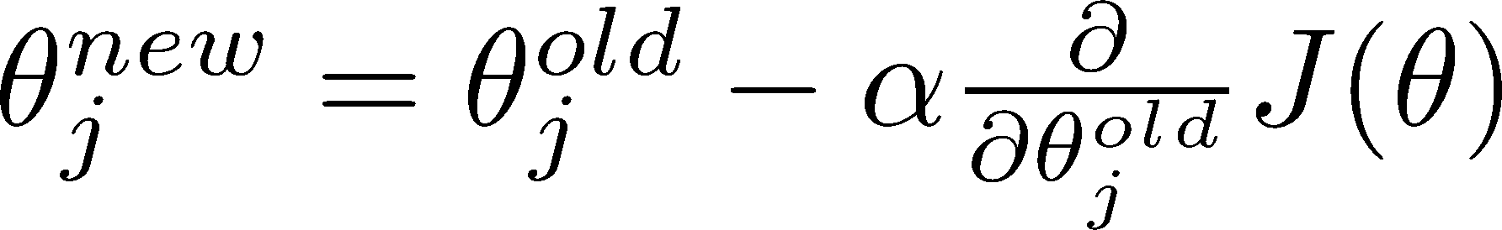
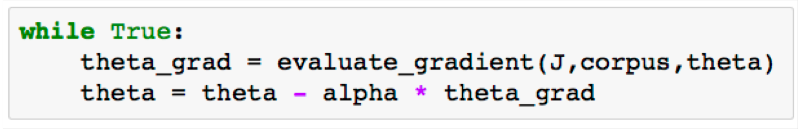
Gradient Descent
Update equation (in matrix notation):
= step size or learning rate
Update equation (for single parameter):
Algorithm:

Slide 29
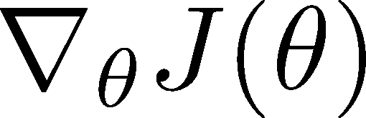
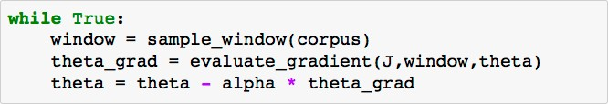
Stochastic Gradient Descent
Problem: is a function of all windows in the corpus (potentially billions!)
  So is very expensive to compute
You would wait a very long time before making a single update!
Very bad idea for pretty much all neural nets!
Solution: Stochastic gradient descent (SGD)
  Repeatedly sample windows, and update after each one
Algorithm:

Slide 30
Lecture Plan
Word meaning
Word2vec introduction
Word2vec objective function gradients
Optimization basics
Looking at word vectors

Slide 31
Thank You!

